Slide 1
Compiler Construction
Teacher : Zulfiqar Ali
Email: Zulfiqar.rafique@nu.edu.pk
Office: No.6,Basement -1 (CS Block 1)

Slide 2
Week 9:
Semantic Analysis
SDD (Syntax Directed Definition)
SDT (Syntax Directed Translation)

Slide 3
Semantic Analysis
Semantic analysis is a phase in the compilation process that focuses on the meaning and logical consistency of a program.
It is often the third phase of a compiler, following lexical and syntax analysis.

Slide 4
Core Functions of Semantic Analysis
Type checking: Check the Data Types
Scope Resolution: Check the Scope of Variables/Functions/Objects
Checking for correct function/method calls: This involves verifying that the number and type of arguments passed to a function or method match its definition.
Checking for declaration errors: The analyzer ensures that every identifier is declared before it is used.
Handling type coercion/casting: The semantic analyzer can perform implicit type conversions

Slide 5
The role of the symbol table
A central data structure for semantic analysis is the symbol table.
The symbol table stores information about every identifier (variable names, function names, etc.) in the source code.
It is typically built during earlier phases, like lexical and syntax analysis, and is heavily used during semantic analysis to:
Store attributes such as data type, scope, and memory location.
Perform quick lookups to find an identifier's attributes whenever it is referenced in the code.

Slide 6
Semantic errors vs. syntax errors
Syntax errors: These are grammar mistakes that violate the structure of the language. For example, a missing semicolon
Semantic errors: These are logical inconsistencies that violate the meaning of the program, even if the program is syntactically valid. For example, int x = 5; string y = "hello"; string z = x + y; is syntactically correct in terms of structure, but semantically wrong in a strongly-typed language because you cannot add an integer and a string.

Slide 7
Working of Semantic Analysis Phase
Semantic Analysis can be implemented by
SDD (Syntax Directed Definition): is a high-level, declarative specification that attaches semantic rules to the productions of a context-free grammar. It defines what needs to be computed. For example, "the type of an expression must be computed and checked for compatibility.“
SDT(Syntax Directed Translation): An SDT is a procedural specification that embeds program fragments (often called semantic actions) directly into the productions of a grammar. It defines how and when the computation happens. For example, "call the type-checking function right after the sub-expression has been parsed."

Slide 8
Syntax Directed Definition (the What)
An SDD is a context-free grammar that has been enhanced with attributes and semantic rules.
It is a formal mechanism for specifying semantic analysis.
Components of an SDD:
Context-Free Grammar: The foundational structure.
Attributes: Pieces of data (e.g., type, value, memory location) associated with grammar symbols
Rules: Semantic rules attached to each grammar production that define how to compute the values of attributes.
Notation:
If X is a symbol and a is its attribute, the value is denoted by X.a
In a parse tree, attributes are stored in the nodes, much like data fields in an object.

Slide 9
Attributes of SDD (The Carriers)
Attributes hold the semantic information that we need to compute and check.
They can be of various data types:
Numbers (e.g., for constant folding)
Types (e.g., int, float, string)
Table References (e.g., pointers to a symbol table entry)
Strings (e.g., variable names)
Code (e.g., sequences of intermediate instructions)

Slide 10
Two Key Types of Attributes
Attributes for non-terminals are classified based on how their values flow through the parse tree.
Synthesized Attributes
Inherited Attributes

Slide 11
Synthesized Attributes
An attribute for a nonterminal A that is defined by a semantic rule at the same node N (where N is labeled A).
How is it calculated?
Its value is defined only in terms of the attribute values of the children of node N and the node N itself.
Analogy: "Bottom up/Bubbling Up" Information flows upwards from the leaves towards the root.
Example: Computing the value of an expression. The value of a parent node is synthesized from the values of its children.
Production Form:
A -> X Y Z
Semantic Rule: A.synth = f(X.synth, Y.synth, Z.synth)

Slide 12
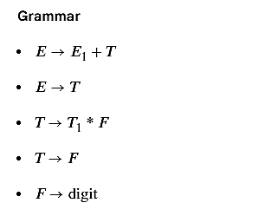
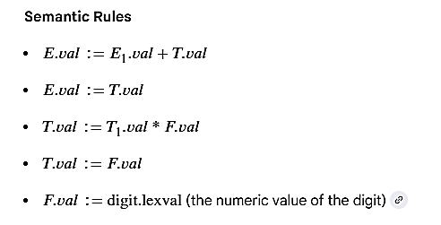
Synthesized Attribute Examples
f

Slide 13
Inherited Attributes
An attribute for a nonterminal B that is defined by a semantic rule at the parent of node N (where N is labelled B).
How is it calculated?
Its value is defined only in terms of the attribute values of the node N's parent, N itself, and N's siblings.
Analogy: "Trickling Down/Top Down" Information flows downwards from the root and across siblings.
Example: Propagating type information or a symbol table down into a variable declaration.
Production Form:
A -> B C D
Semantic Rule: B.inh = f(A.inh, C.synth, D.synth)

Slide 14
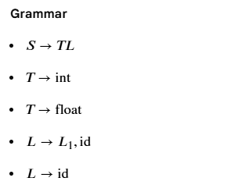
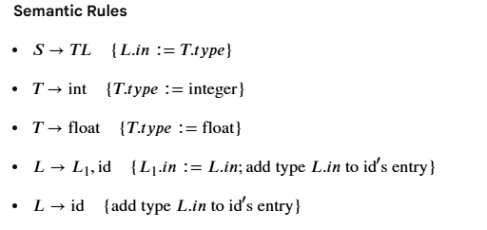
Inherited Attributes Example
Consider a simple language with integer and floating-point variables. An inherited attribute can be used to pass the type information down the parse tree

Slide 15
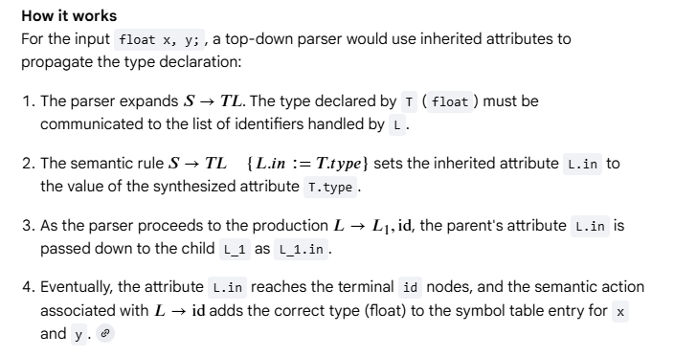
Inherited Attributes Example

Slide 16
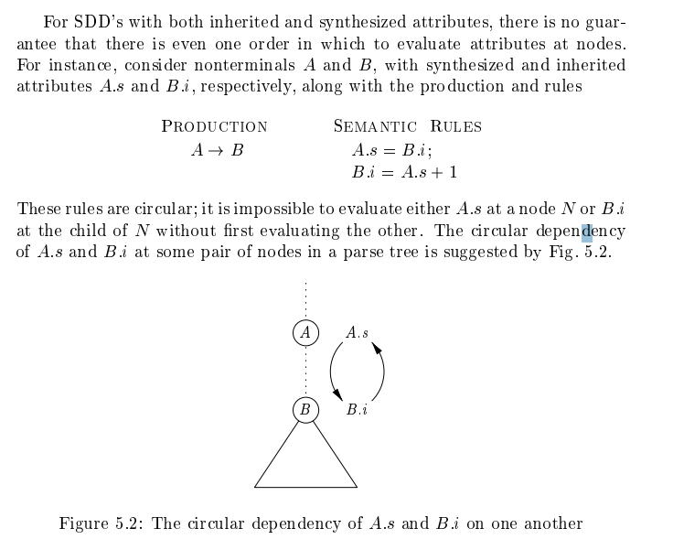
Circular Dependency of Inherited & Synthesized Attributes

Slide 17
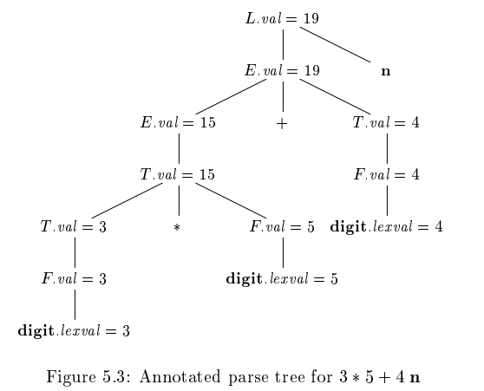
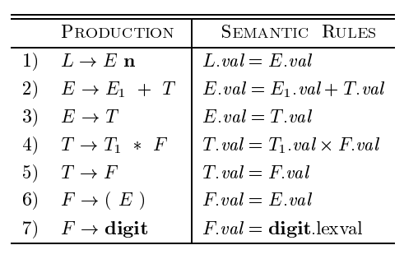
Annotated Parse Tree Examples 1:
3 * 5 + 4 n, construct Annotated Parse tree using Following Grammar

Slide 18
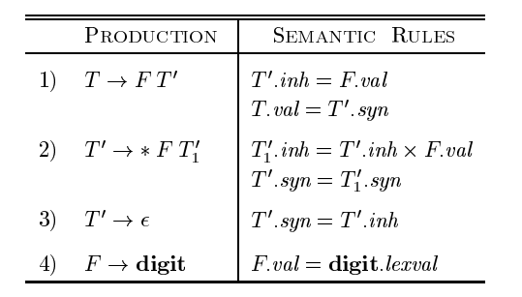
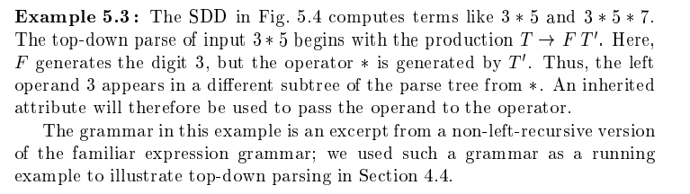
Annotated Parse Tree Examples 2:
Construct Parse Tree for the 3 * 5

Slide 19
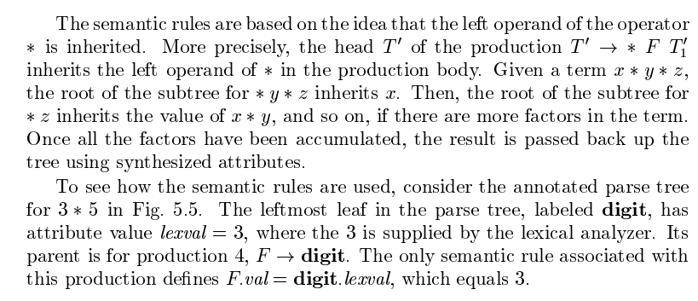

Slide 20
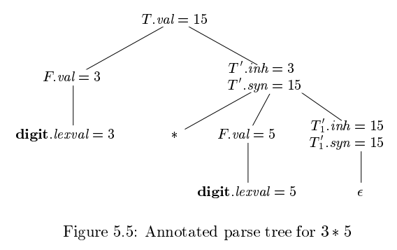

Slide 21
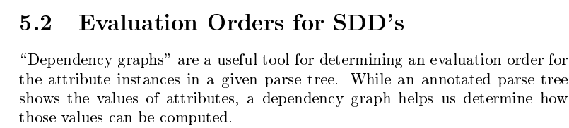
The evaluation order of an SDD (Syntax-Directed Definition) is any sequence that computes attributes after all their dependencies have been calculated. It's obtained from a topological sort of the dependency graph - ensuring no attribute is used before it's computed.

Slide 22
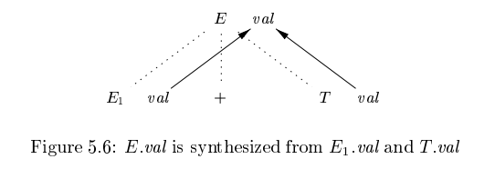
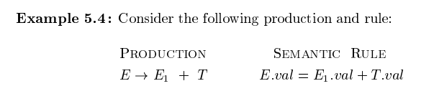
Dependency Graph
The dependency graph is a diagram with:
Nodes (Circles): Each circle represents one specific value that needs to be calculated.
Arrows (Edges): An arrow from value A to value B means: "To calculate value B, you first need to know value A."

Slide 23
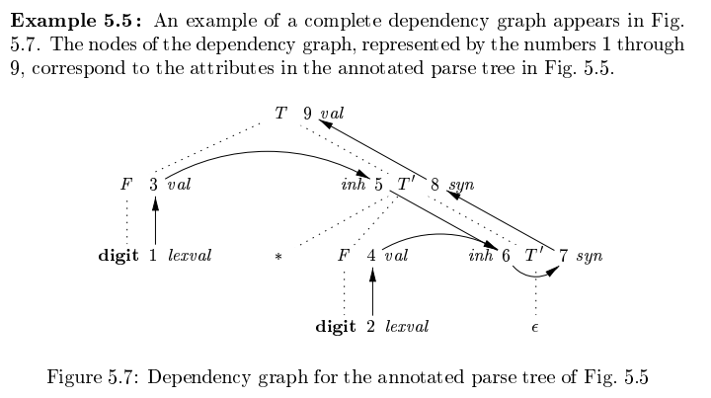

Slide 24
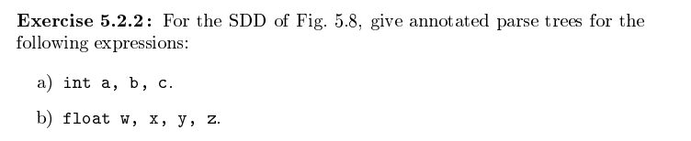

Slide 25
S-Attributes
Its value is computed only from the values of its children nodes in the parse tree. Information flows upwards from the leaves to the root.
Key Property: They are guaranteed to be non-cyclic (no circular dependencies), making them safe and easy to evaluate.
How to Evaluate: You can calculate all the attributes with a simple Postorder traversal (visit children from left to right, then evaluate the parent). This fits perfectly with bottom-up parsing (like LR parsing), where the order of operations is naturally post-order.
Example: A.s=B.s+C.s+D.s
A.s=2×(B.s+C.s)×D.s

Slide 26
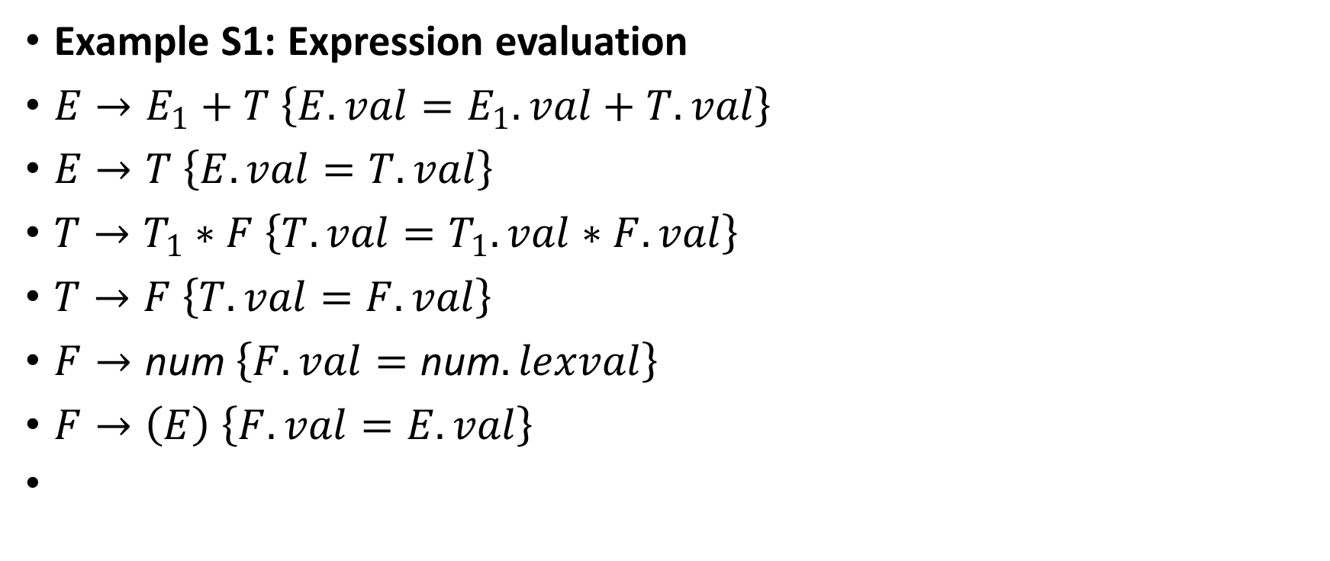
S-Attribute Example
Example S1: Expression evaluation
$E→E_{1}+T \left\{E.val=E_{1}.val+T.val\right\}$
$E→T \left\{E.val=T.val\right\}$
$T→T_{1}∗F \left\{T.val=T_{1}.val∗F.val\right\}$
$T→F \left\{T.val=F.val\right\}$
$F→\text{num} \left\{F.val=\text{num}.lexval\right\}$
$F→\left(E\right) \left\{F.val=E.val\right\}$

Slide 27
L-Attributed
Both synthesized and inherited attributes, but with strict rules on the inherited ones.
Its value is passed down from a parent or from a sibling. Information can flow downwards and sideways (but only left-to-right).
The "L" Rule (Left-to-Right): When calculating an inherited attribute for a symbol in a production, you can only use:
Inherited attributes from the production's head (the parent).
Attributes (synthesized or inherited) from symbols to its left in the same production.
Key Property: This left-to-right restriction ensures the dependency graph has no cycles and that attributes can be evaluated during a top-down, left-to-right traversal of the parse tree. This makes them ideal for top-down parsing.

Slide 28
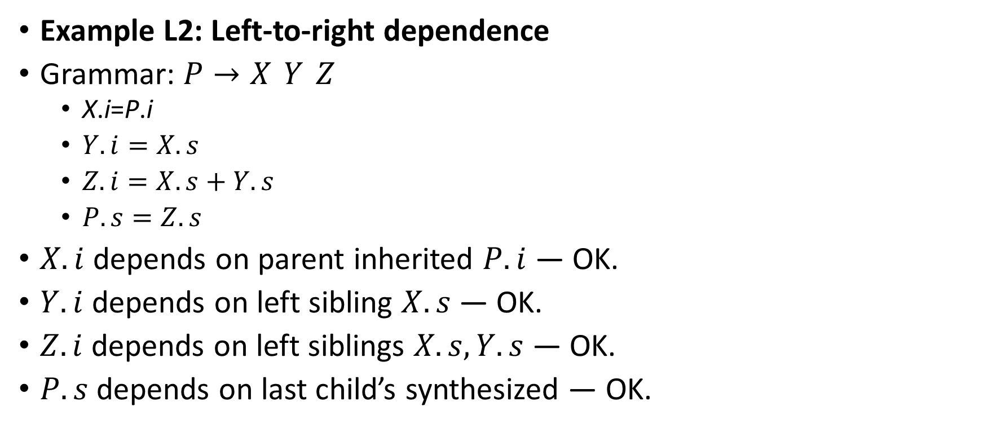
Examples oF L-Attribute
Example L2: Left‑to‑right dependence
Grammar: $P→X Y Z$
X.i=P.i
$Y.i=X.s$
$Z.i=X.s+Y.s$
$P.s=Z.s$
$X.i$ depends on parent inherited $P.i$ — OK.
$Y.i$ depends on left sibling $X.s$ — OK.
$Z.i$ depends on left siblings $X.s,Y.s$ — OK.
$P.s$ depends on last child’s synthesized — OK.

Slide 29
S-Attribute Rules
Only synthesized attributes are allowed.
No inherited attributes appear anywhere in the definition.
Semantic rules can compute only synthesized attributes of the left‑hand side nonterminal.
Dependencies flow strictly bottom‑up (from children to parent).
Evaluation order: Postorder traversal (bottom‑up) works

Slide 30
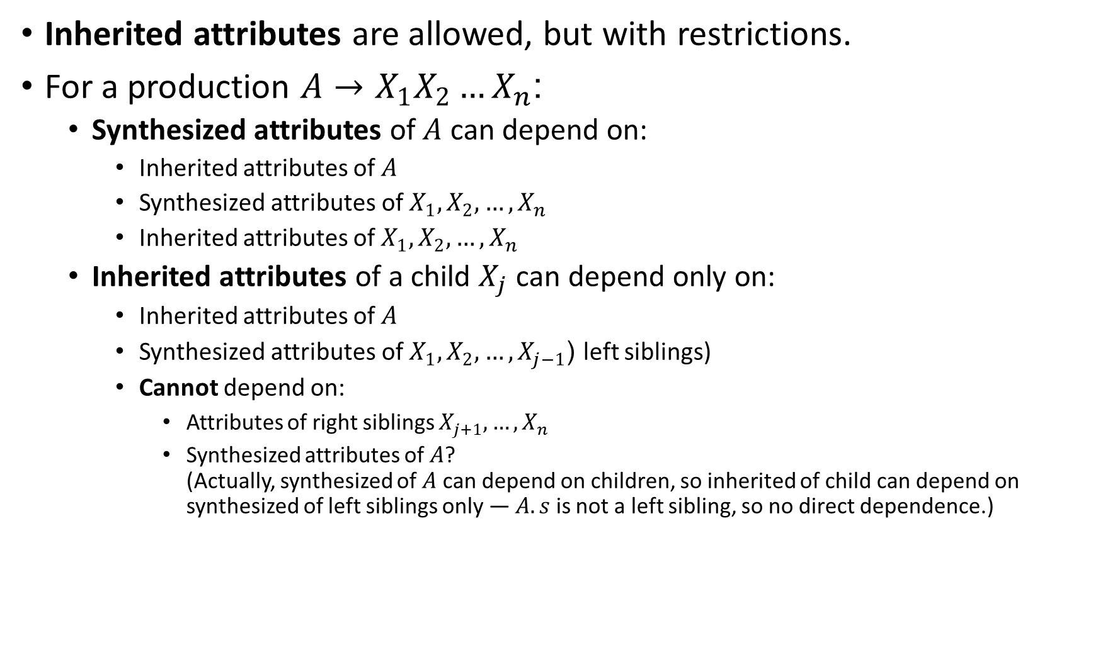
L-Attribute Rules
Inherited attributes are allowed, but with restrictions.
For a production $A→X_{1}X_{2}…X_{n}$:
Synthesized attributes of $A$ can depend on:
Inherited attributes of $A$
Synthesized attributes of $X_{1},X_{2},…,X_{n}$
Inherited attributes of $X_{1},X_{2},…,X_{n}$
Inherited attributes of a child $X_{j}$ can depend only on:
Inherited attributes of $A$
Synthesized attributes of $X_{1},X_{2},…,X_{j−1}$ (left siblings)
Cannot depend on:
Attributes of right siblings $X_{j+1},…,X_{n}$
Synthesized attributes of $A$? (Actually, synthesized of $A$ can depend on children, so inherited of child can depend on synthesized of left siblings only — $A.s$ is not a left sibling, so no direct dependence.)

Slide 31
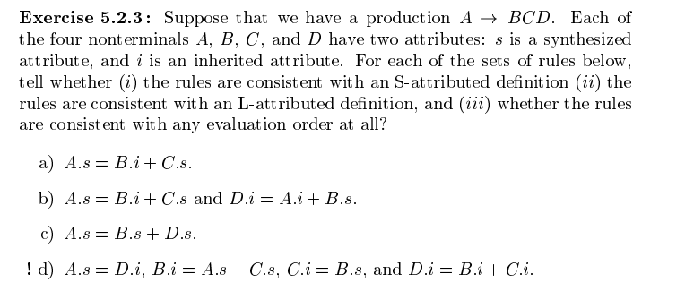

Slide 32
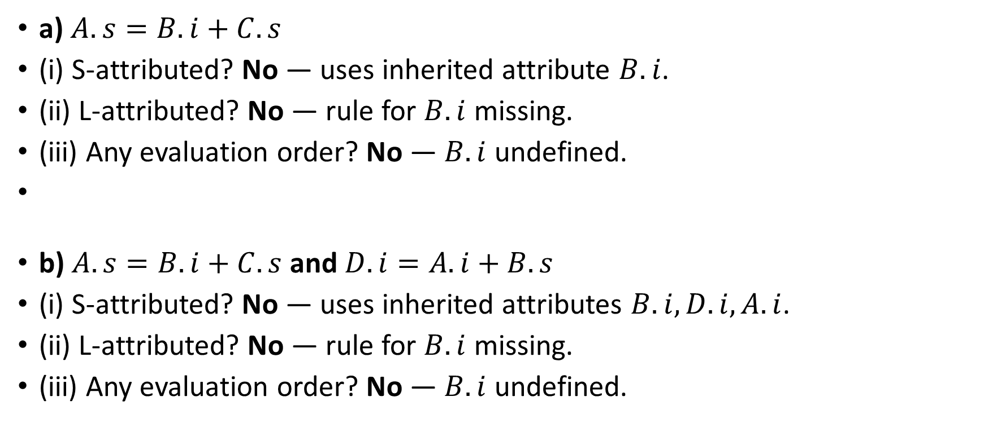
Solution:
a) $A.s=B.i+C.s$
(i) S‑attributed? No — uses inherited attribute $B.i$.
(ii) L‑attributed? No — rule for $B.i$ missing.
(iii) Any evaluation order? No — $B.i$ undefined.
b) $A.s=B.i+C.s$ and $D.i=A.i+B.s$
(i) S‑attributed? No — uses inherited attributes $B.i,D.i,A.i$.
(ii) L‑attributed? No — rule for $B.i$ missing.
(iii) Any evaluation order? No — $B.i$ undefined.

Slide 33
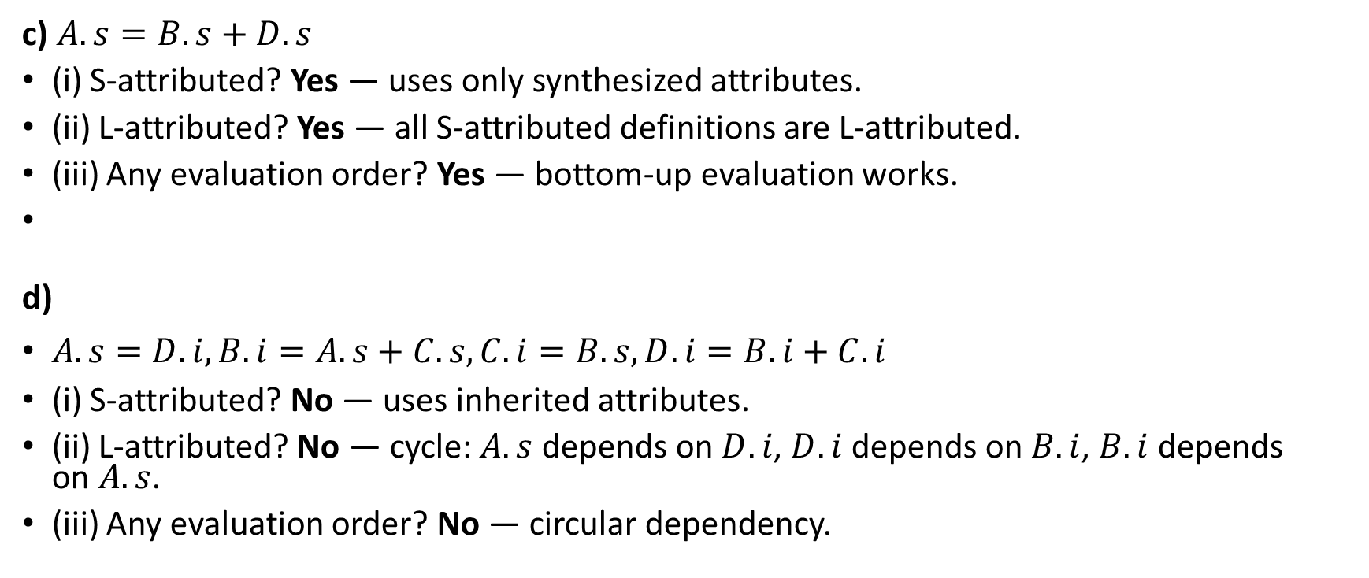
c) $A.s=B.s+D.s$
(i) S‑attributed? Yes — uses only synthesized attributes.
(ii) L‑attributed? Yes — all S‑attributed definitions are L‑attributed.
(iii) Any evaluation order? Yes — bottom‑up evaluation works.
d)
$A.s=D.i, B.i=A.s+C.s, C.i=B.s, D.i=B.i+C.i$
(i) S‑attributed? No — uses inherited attributes.
(ii) L‑attributed? No — cycle: $A.s$ depends on $D.i$, $D.i$ depends on $B.i$, $B.i$ depends on $A.s$.
(iii) Any evaluation order? No — circular dependency.

Slide 34
Syntax Directed Translation Applications
Constructions of Syntax Trees
From Syntax Tree building Intermediate code
Ensuring compatible data types performed in the code

Slide 35
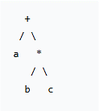
Construction of Syntax Trees
Syntax Tree: It's a tree representation of the source code where:
Every node represents a programming construct (like an operation, a variable, a number).
The children of a node represent the meaningful parts of that construct.

Slide 36
Construction of Syntax Trees
We use an SDD to define how to build the tree. The key idea is to add attributes and semantic rules to the grammar.
The Key Attribute: node
This synthesized attribute holds a pointer/reference to a node in the syntax tree.
The Key Functions:
Leaf(num) or Leaf(id): Creates a leaf node for a number or identifier.
Node(op, child1, child2): Creates an internal node with an operator and pointers to its children (the nodes for its operands).

Slide 37
The Building Blocks
Two constructor functions to create nodes:
1. Leaf(op, val) - For Leaf Nodes
Use Case: Creates nodes for the most basic elements—the leaves of the tree.
What it represents: Identifiers (variable names like a, count), numbers (like 5, 42), and other literal values.
What's inside:
An op field: A label indicating the type (e.g., id for identifier, num for number).
A val field: The actual lexical value (the text "a" or the number 42).
Creates nodes for: a, b, 10, "hello"

Slide 38
The Building Blocks
Two constructor functions to create nodes:
2. Node(op, c₁, c₂, ..., cₖ) - For Interior Nodes (The Operations)
Use Case: Creates nodes for operations that combine other nodes.
What it represents: Operators like +, -, *, /, or other constructs like function calls.
What's inside:
An op field: The label of the operator (e.g., +, *, call).
k child fields: Pointers/references to the syntax tree nodes of its operands (c₁, c₂, etc.).

Slide 39
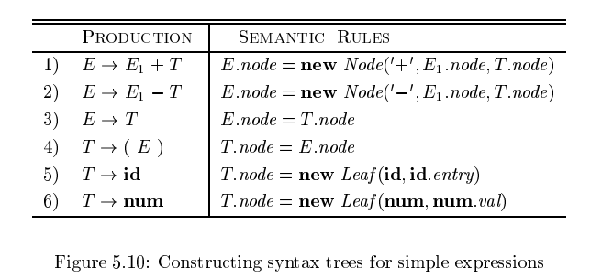
Examples: S-Attributed SDD
f

Slide 40
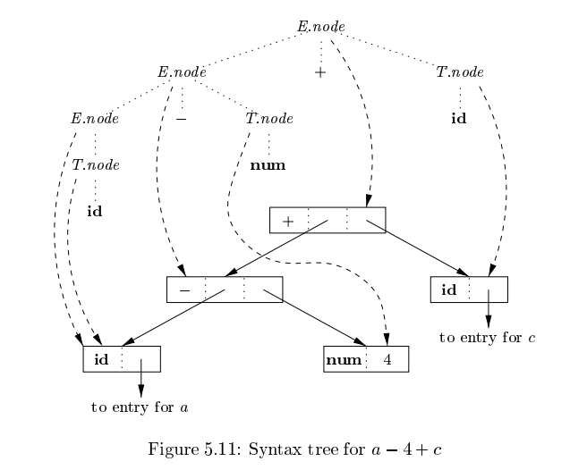
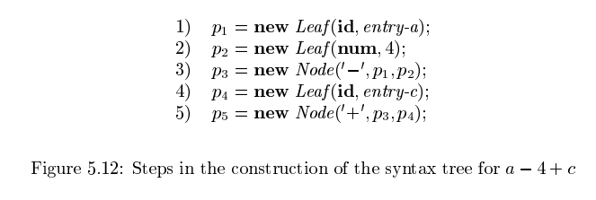

Slide 41
Examples: S-Attributed SDD (For Bottom-Up Parsing)
Production (CFG) | Semantic Rules (SDD)
E→E1+T | E.node = Node('+', E₁.node, T.node)
E→T | E.node = T.node
T→T1∗F | T.node = Node('*', T₁.node, F.node)
T→F | T.node = F.node
F→(E) | F.node = E.node
F→id | F.node = Leaf(id.lexeme)
F→num | F.node = Leaf(num.value)

Slide 42
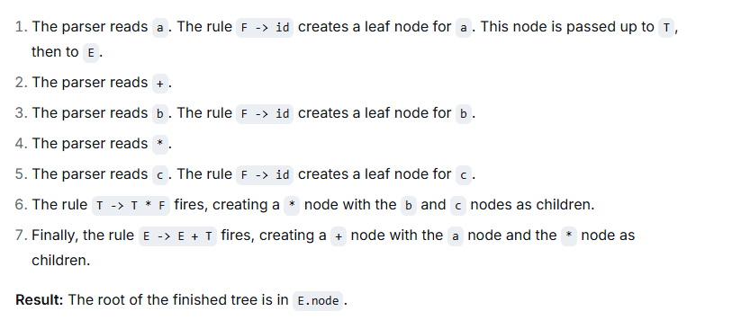
Building Syntax tree for a + b * c:
Using above Grammar & Syntax Rules

Slide 43
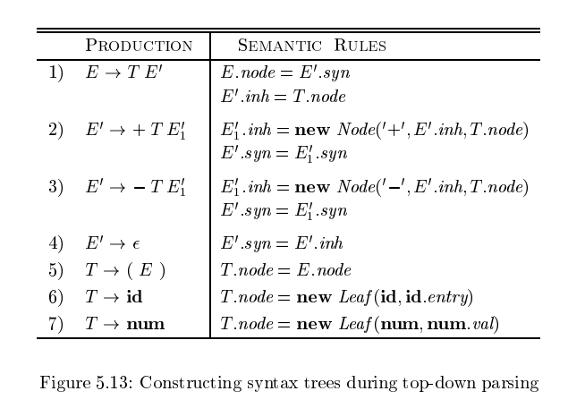
Examples: L-Attributed SDD

Slide 44
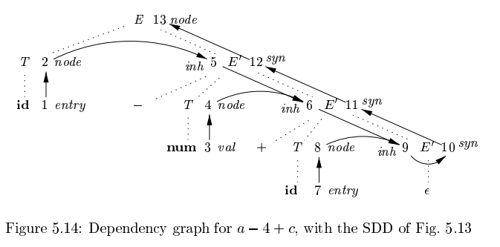

Slide 45
Syntax Directed Translation Schemes
A syntax-directed translation scheme (SDT) is a context free grammar with program fragments embedded within production bodies.
The program fragments are called semantic actions and can appear at any position within a production body.
we place curly braces around actions. if braces are needed as grammar symbols, then we quote them.

Slide 46
SDTs Implementation
Any SDT can be implemented by first building a parse tree and then performing the actions in a left-to-right depth-first order; that is, during a pre-order traversal.
Typically, SDT's are implemented during parsing, without building a parse tree
.

Slide 47
SDT Classes for Parser Integration:
LR-Parsable Grammars with S-Attributed SDDs:
Actions placed at end of productions.
Execute during reduction in bottom-up parsing.
LL-Parsable Grammars with L-Attributed SDDs:
Actions can be embedded inside productions.
Execute during top-down parsing when symbols to their left are matched.

Slide 48
Postfix SDTs
A Syntax-Directed Translation Scheme where all semantic actions are placed at the end of grammar productions.
Used when:
Parsing is bottom-up (LR parsing)
The SDD is S-attributed (all attributes are synthesized)
Actions execute when the parser reduces the production body to its head.
Example Idea: For production: A→XYZ→XYZ { action } The action runs exactly when XYZ is reduced to A.

Slide 49
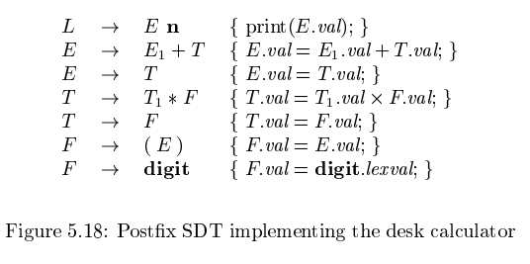
Desk Calculator Example
Each action computes values (synthesized attributes) when reduction happens.
At the final reduction L→En, the result E.val is printed.

Slide 50
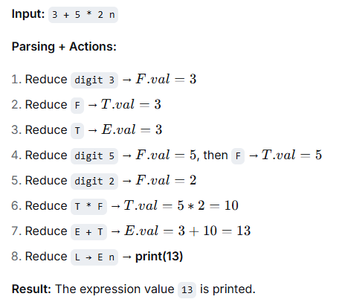
How It Works in Parsing
f

Slide 51
Parser-Stack Implementation of Postfix SDTs
In bottom-up (LR) parsing, we can store attributes directly on the parser stack alongside grammar symbols.
Each stack entry = (grammar symbol or parser state, attribute value).
When a reduction happens, we compute new attributes for the head using attributes from body symbols on the stack.

Slide 52
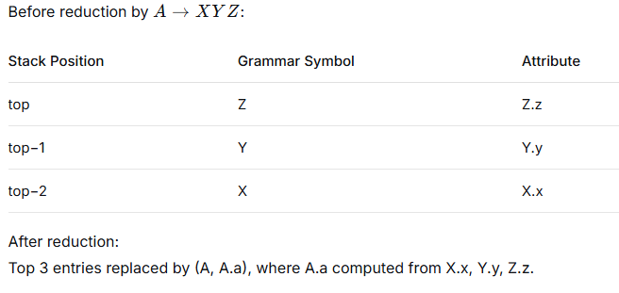
Example

Slide 53
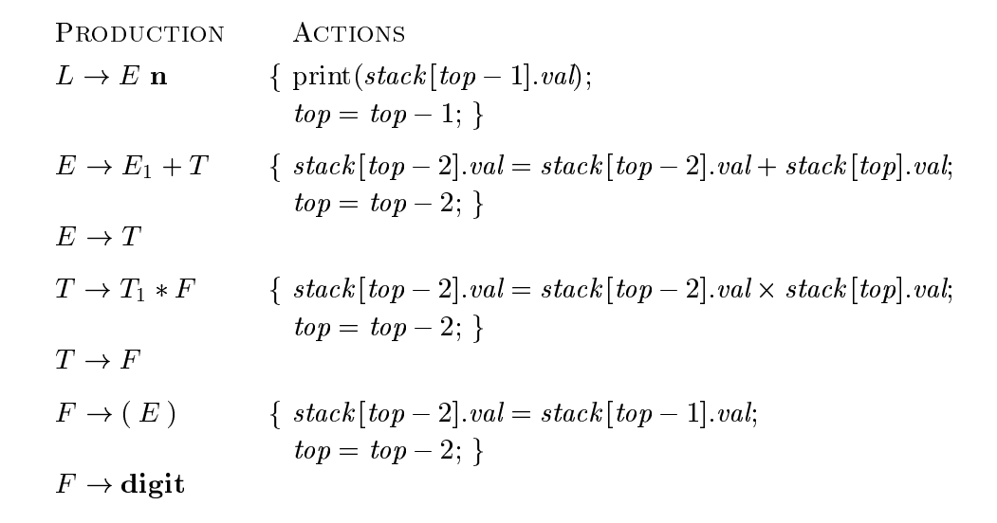

Slide 54
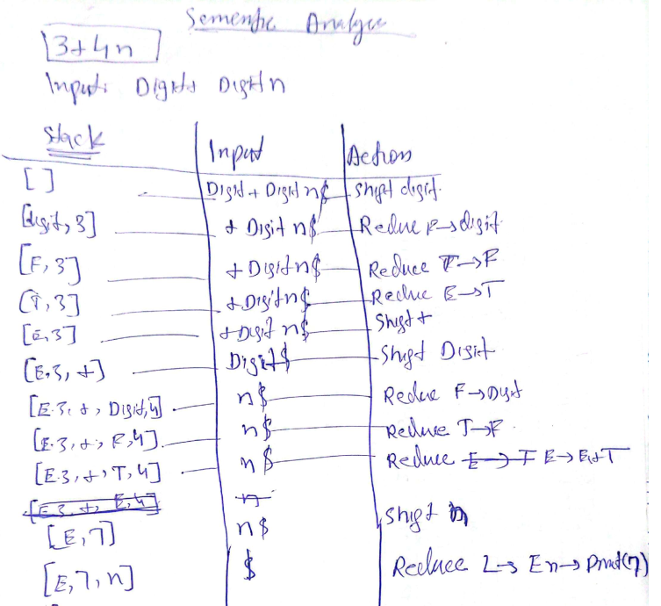

Slide 55

Stack Indexing in Practice
Assume:
Stack array stack[], top = index of top.
Each record has .val = synthesized attribute value.
For production E→E1+T
E1.val is at stack[top−2].val
After computing E.val=E1.val+T.val
​we pop 2 symbols (remove + and T), so stack[top−2] becomes the new top, holding E.

Slide 56
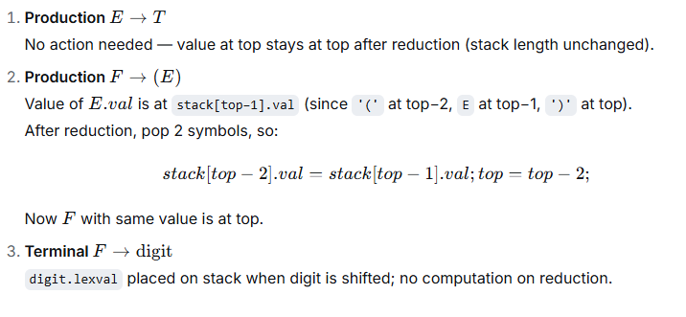
More Examples

Slide 57
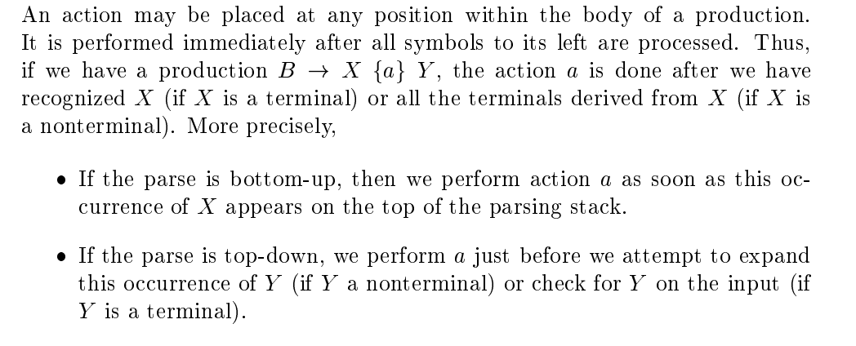
SDT’s with actions inside productions

Slide 58
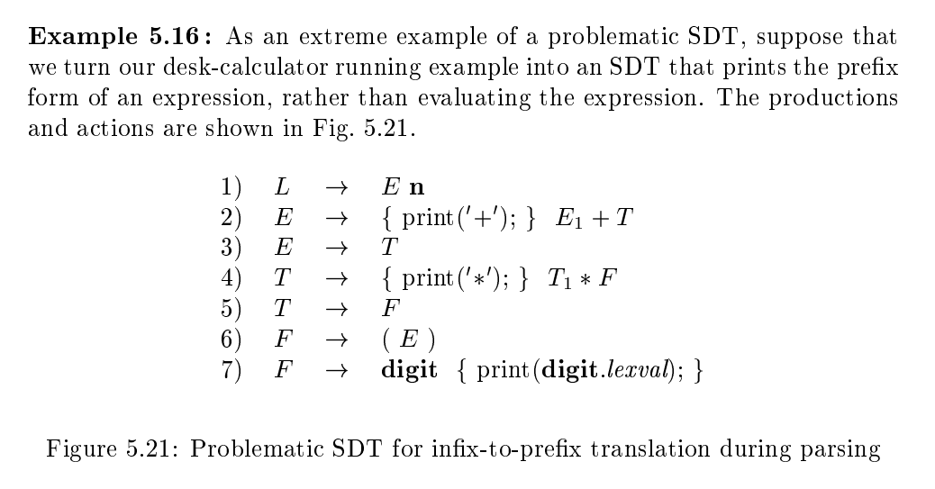

Slide 59

Why It is problematic SDT?
The grammar in Figure 5.21 tries to print expressions in prefix form (e.g., + 2 3 instead of 2 + 3). Productions like:
force the parser to print '+' or '*' before it knows if the operator actually appears in the input for that production.
Why It Fails
In top-down parsing: The action print('+') happens immediately when we choose the E → E + T production, but the input might actually be just T (no plus).
In bottom-up parsing: Using marker nonterminals (like M → ε for actions) causes shift/reduce conflicts because the parser can’t decide whether to reduce an empty action or shift the next token.

Slide 60
Simple Example
Input = 3
The grammar expects L → E n, and E could go to E + T or T. If it incorrectly picks E → {print('+')} E + T, it prints + but then finds no + in the input — wrong output and possible parse failure.

Slide 61
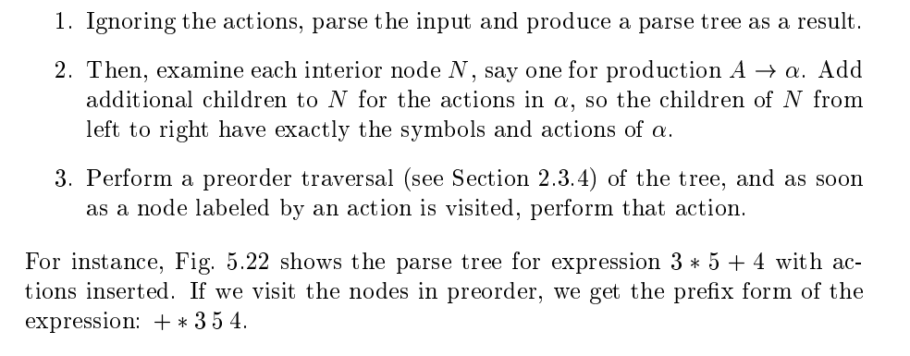
Any SDT can be implemented as follows:

Slide 62
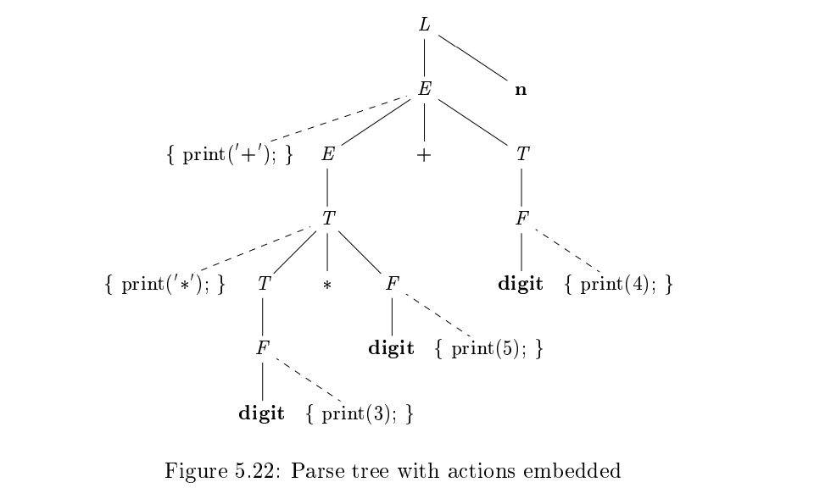
d

Slide 63
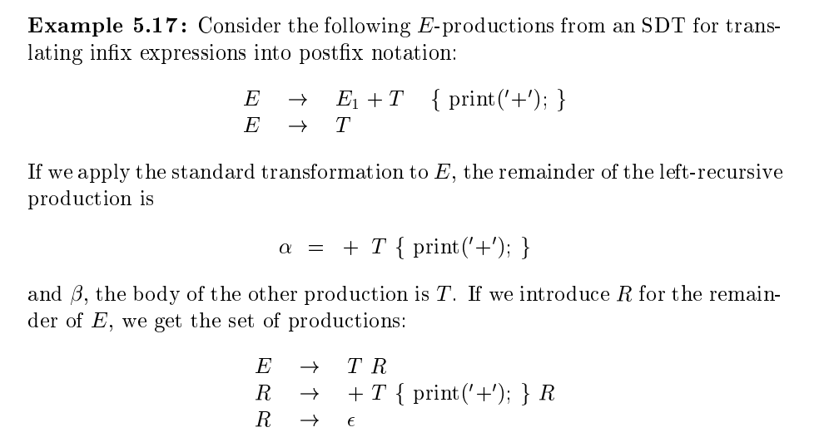


Eliminating Left Recursion for SDT’s

Slide 64
Infix VS Postfix Notation
Infix expressions are readable and solvable by humans. We can easily distinguish the order of operators, and also can use the parenthesis to solve that part first during solving mathematical expressions.
The computer cannot differentiate the operators and parenthesis easily, that's why postfix conversion is needed.

Slide 65
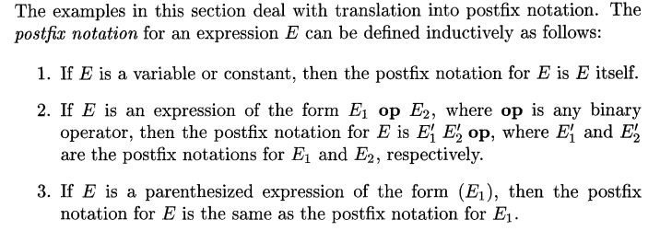
Postfix Notation

Slide 66
Postfix Notation (Example)
E = E₁ op E₂ postfix will be E = É₁ É₂ op
(9-5)+2 postfix will be 95-2+
Parentheses are not needed in postfix conversion
9-5+2 postfix will be 952-+
952+-3*
Scan from left, first we face + sign, solve 52+ will be 7
Now 97-3*, first we face – sign, solve 97- will be 2
Now 23* solve it as 6

Slide 67
Convert into Postfix
A * B + C / D

Slide 68
Convert into Postfix
A * B + C / D
A * (B + C) / D

Slide 69
Convert into Postfix
A * B + C / D
A * (B + C) / D
A * (B + C / D)

Slide 70
Convert into Postfix
A * B + C / D | A B * C D / +
A * (B + C) / D | A B C + * D /
A * (B + C / D) | A B C D / + *

Slide 71
Infix to Prefix Expressions
Input: s = a*(b+c)/d
Output: /*a+bcd Explanation:
The infix expression is a*(b+c)/d. First, inside the brackets, b + c becomes +bc. Now the expression looks like a*(+bc)/d. Next, multiply a with (+bc), so it becomes *a+bc. Finally, divide this result by d, so it becomes /*a+bcd.

Slide 72
Infix to Prefix Expressions
Input: s = (a-b/c)*(a/k-l) Output: *-a/bc-/akl
Explanation:
The infix expression is (a-b/c)*(a/k-l). First, inside the brackets, b/c becomes /bc and a/k becomes /ak.
Now the expression looks like (a-/bc) * (/ak-l).
Next, handle the subtractions: a-/bc becomes -a/bc, and /ak-l becomes -/akl. Finally, multiply the two results: (-a/bc * -/akl) becomes *-a/bc-/akl.

Slide 73
Try These
(A + B) * (C - D)
a * (b + c) / d

Slide 74
Reference:
Compilers: Principles, Techniques, and Tools 2nd Edition by Alfred Aho , Jeffrey Ullman, Ravi Sethi, Monica Lam
Introduction to Compilers and Language Design | Second Edition | Prof. Douglas Thain - University of Notre Dame

